Slide 1
MA2142: COURSE PROJECT
Group 1
Presented by:
Akhil Gattu-BM20BTECH11001
Dhanush Pittala-BM20BTECH11004
Vibhuvan Kumar M-EE20BTECH11055
Santosh Kumar-MA20MSCST11017
Rupa-MA20MSCST11014
Vijay Ponuku -ES19BTECH11011

Slide 2
Outlines
Brief descriptions of the dataset
Objective
Diagnostic and remedies of regression
Getting the optimized coefficients of regression and calculating its adjusted-r^2-value
Residual plots and histogram
Added-Variable plots
Conclusion

Slide 3
Brief descriptions of the dataset
The dataset is related to the life expectancy of 193 countries.
Link: https://www.kaggle.com/kumarajarshi/life-expectancy-who
Number of features in the dataset = 22 and Number of entries= 2938
Features: Life expectancy, Adult mortality rate, Alcohol ,Infant deaths , Percentage expenditure, Hepatitis B, Measles, BMI, Under- five-deaths, Polio, Total expenditure etc.

Slide 4
Objective
How the life expectancy is being affected by the other features present in the dataset?
What are the features that are significantly affecting the life expectancy?
Response Variable: Life expectancy (in years)
Predictor Variables: Adult mortality, Infant deaths, Alcohol, Total expenditure, Hepatitis B, Measles, BMI etc.

Slide 5
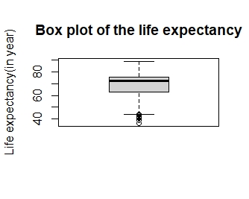
Boxplot
Mean life expectancy is around 70 years.
Median life expectancy is round 72 years
Life expectancy of the outliers 35-45 years.
50% of the data is between 62-78 years.
Minimum life expectancy is 36.30 years.
Maximum life expectancy is 89 years.

Slide 6
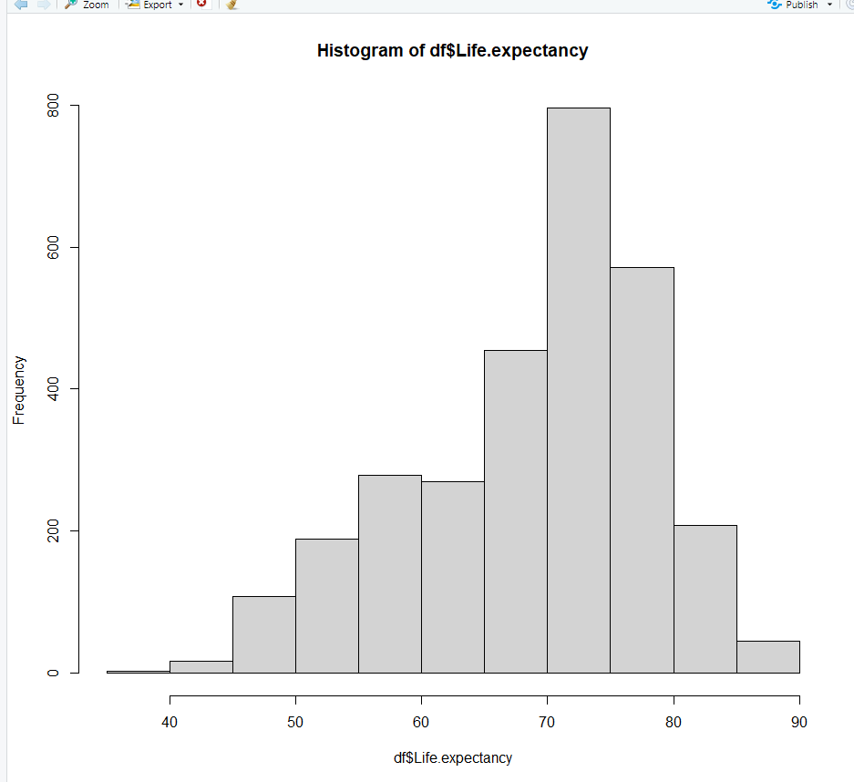
Histogram of life expectancy
Here, we see that most of our data of life expectancy lies in 70-80 years age.
We know that age follows normal distribution.
From these 2 points, we can conclude that life expectancy can be approximately normally distributed.

Slide 7
Remedies for regression
Multicollinearity: As most of the predictor variables have a small value, we don’t have to calculate the VIR number here.
Regression
remedies
Homoscedasticity: Remedy is not required here as it passes GQ test.
Normality: Remedy not required as the histogram of residuals is approximately Gaussian
Autocorrelation: We use the orcutt library in R to transform the predictor variables

Slide 8
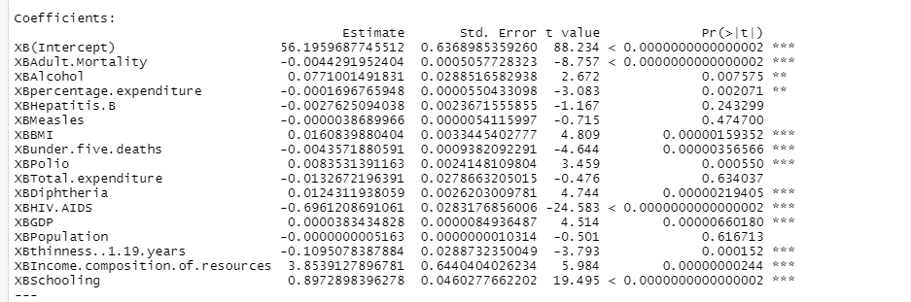
Performing Regression Analysis
After performing all the tests and remedies along with AIC test to evaluate the optimal set of parameters, we obtained the following results
Accuracy (Adjusted R squared value) = 0.9433 (94.33%),
AIC value = 13997.24 obtained through backward stepwise regression.
P-Value is much less than alpha value (0.05)

Slide 9
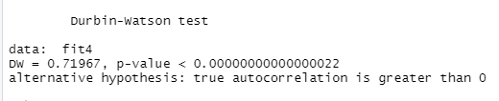

Testing autocorrelation
Alpha = 0.05 for the tests shown below.
Initially, the model fails dwtest(has a positive autocorrelation)

Slide 10
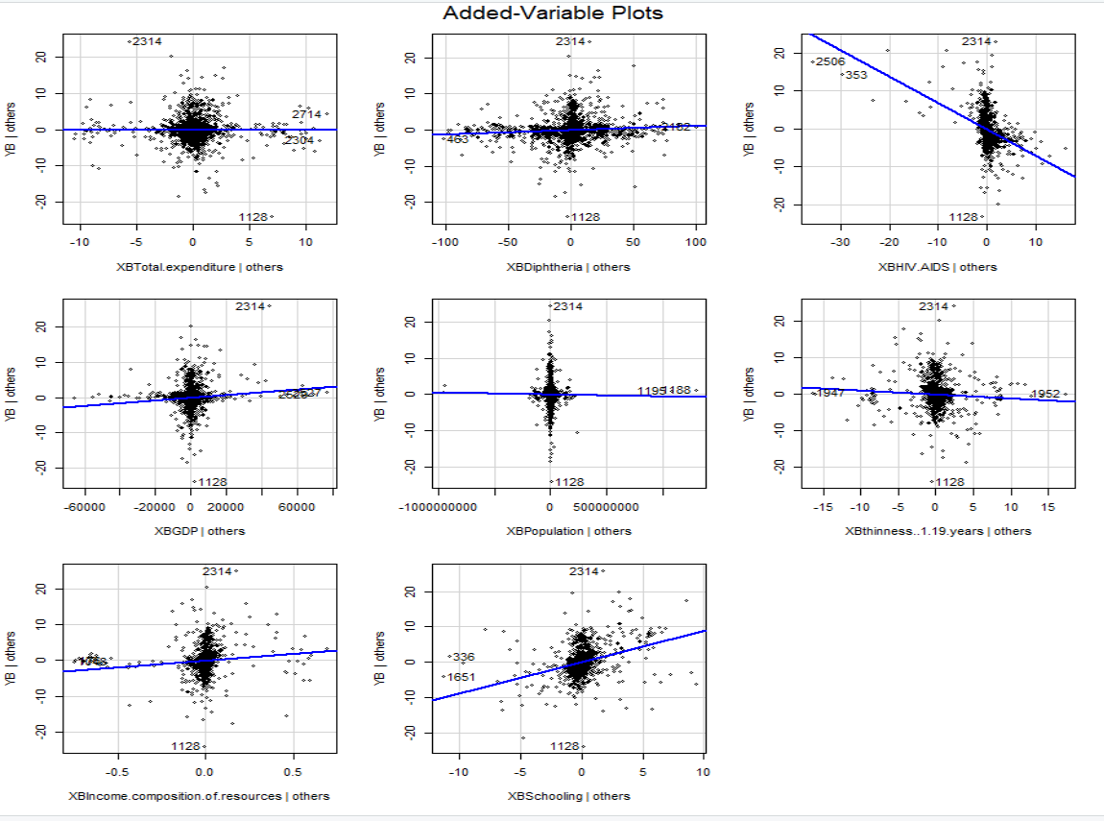
Added variable plots

Slide 11
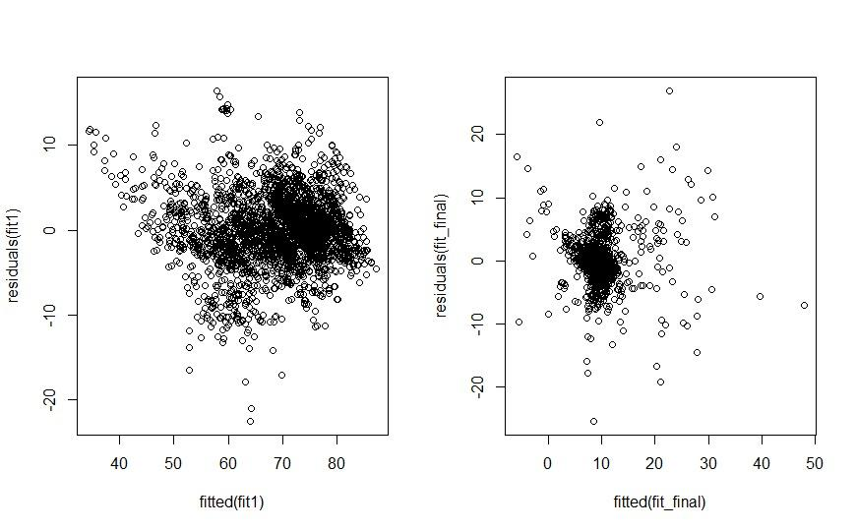
GQ test on the final model
The values in the new plot are not scattered.
Running GQ test : p-value = 0.2392. As p-value is greater than 0.05, We accept the null hypothesis i.e. the new model is Homoscedastic.

Slide 12
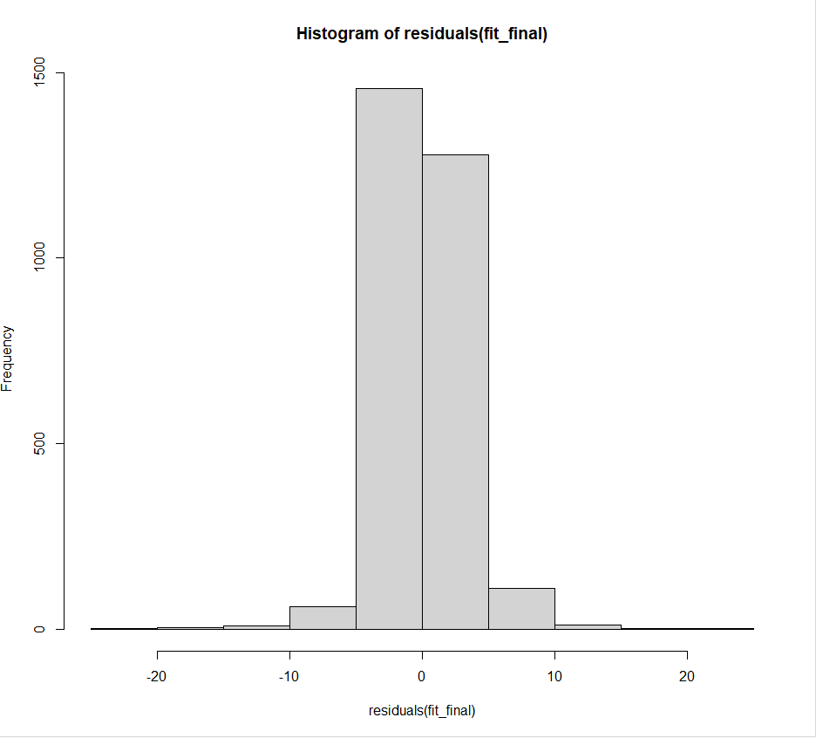
Histogram of residuals
Notes:
The Histogram plot of residuals resembles a Gaussian. So, we can say that the residuals calculated from the optimized model is normally distributed.

Slide 13
CONCLUSION
We have performed all the tests of Normality, Homoscedasticity, Multicollinearity, Autocorrelation and AIC tests and also applied remedies to the data set which has the adjusted-r-squared value as 94.33%
Some parameters where the coefficients are negative influence the Life expectancy
Diseases which do not have cure like AIDS or fatal diseases like Hepatitis B have a negative impact on the life expectancy.
Excessive population, obesity, number of child deaths under 5-years contribute negatively to the life expectancy too
Schooling, Income and GDP are crucial for living; hence they have a positive impact on life expectancy(Income has the greatest impact on life expectancy).
Polio and Diphtheria have very less impact on life expectancy as they are either curable or preventable
The intercept value is much higher than the values of coefficients, it is approximately equal to the mean of life expectancy

Slide 14
Thank You

